Slide 1


Prototype Submission Phase

Slide 2
Team Name and Member Details
Team Name : ClanOfOptimists
Member 1 : Pranitha M K Member 2 : Kiran Kumar Member 3 : Richard
Theme:
[Transportation and Logistics]

Slide 3
Problem Statement
Objective of The project is to create and design a system which solves problems faced by the Indian public transport system revolves around the unwillingness of the users to opt for public transport . One of the most important, yet easily unnoticed, aspects about fleet management is preventative care and maintenance. It's not the quality of a vehicle's build that causes a premature demise, but rather improper maintenance. Given a lot of fleet data, our team would analyze it, so we can promote a more pro-active, instead of reactive, approach to maintenance, Thus ultimately saving a company money and preventing unnecessary waste.

Slide 4
Solution
Public Transport is not maintained with proper hygiene which discourages a large proportion of the commuters from using them. Public Transport Fleet management is all about keeping costs reasonable, maximizing profitability, and minimizing risk . The app will notify the admin which vehicles need what service, and the user can easily locate what vehicles need service by using augmented reality and location data! It chiefly takes into consideration the work load over engine to compute the next required service check but also the other two main features are that it will use the latitude longitude data along with timestamp to check for weather log at that day, and also it would leverage the location data to find out terrain of the location. The weather and terrain form two important factor alongside of mileage/fuel efficiency of vehicle these all parameters are taken into consideration to find out when is next maintenance required and what type of maintenance is required. Based on location it suggests the nearest service station at the time of required maintenance.
Frameworks/Tools/Technologies used are Built With Android Studio Firebase Echo Ar PyreBase Python Java.
Assumptions, constraints, and solution decision points (Reason behind choosing a technology) are No fault or the errors by the driver and on the roads , fluctuation of network connectivity in terrain, As its handy to use we have chosen the Mobile application.
The solution can be implemented with ease when we have the details of the public vehicles. Its user friendly , secure , Easily Maintained.
solution Approach: We propose the development of a The python script communicates to the app by a firebase database. The authentication is also done from firebase. We used a t-test to find what vehicles need maintenance. which can be used to record every detail pertaining to a vehicle. The details may include the date of purchase, tire condition, engine oil status, etc. As a result, the user is provided with a complete history of the vehicle, thereby allowing him to make more informed choices. The novelty of idea: Real-time monitoring of vehicle health.
Novel and flawless use of Android. Transparent Highly Secure .We believe that our solution will urge people to use public transport and also it serves as a monitoring mechanism for authorities to maintain public transport better. Dealing with a lot of data was difficult as it caused for very long run times just to work with the data. Qualitative Accomplishments. We managed to find vehicles that needed maintenance and present that in a very user-friendly way! We also learned a lot about data analysis techniques and managed to work efficiently as a team the whole time.
App that predicts when a vehicle will require servicing and the type of servicing.
Admin can log into the app and check up on their fleet of vehicles. The admin can add new vehicle by simply scanning the QR code containing vehicle number .From there, a python script manipulated the data given to find vehicles that need service/maintenance.

Slide 5
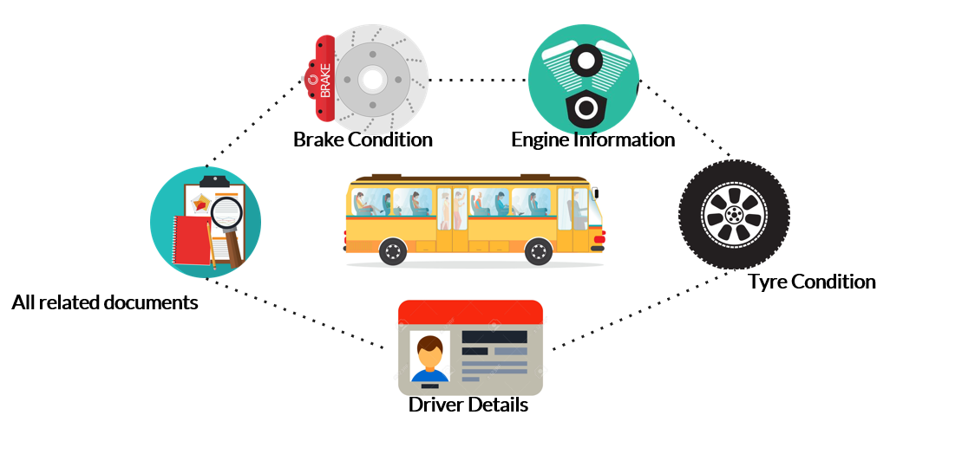
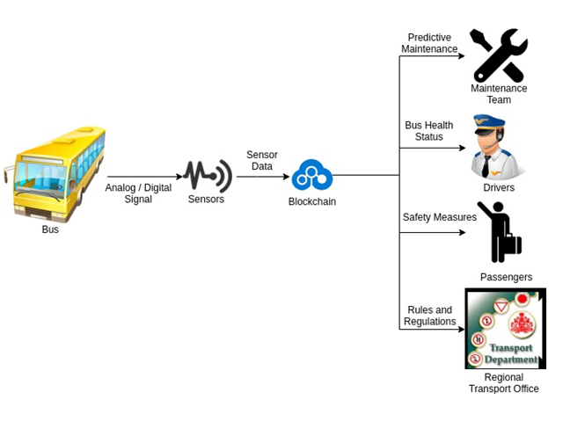
Methodology
[ Include Concept, principles, elements and components. ]

Slide 6
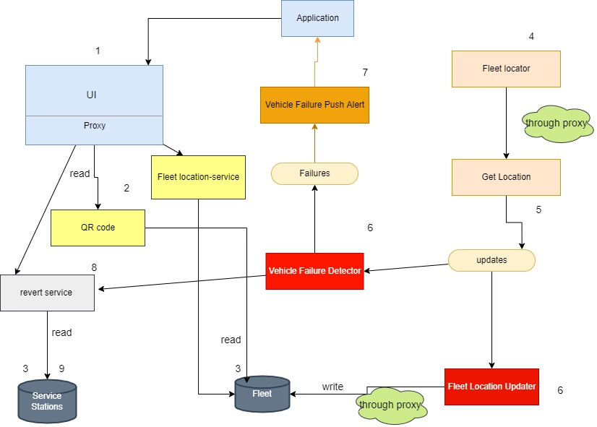
Architecture Diagram

Slide 7
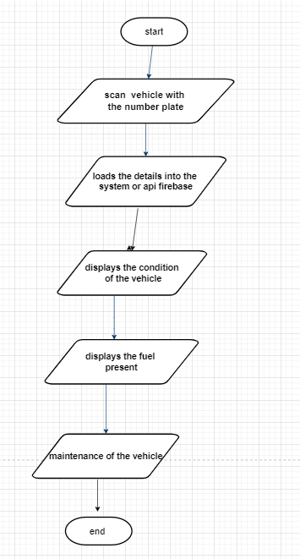
Flowchart

Slide 8
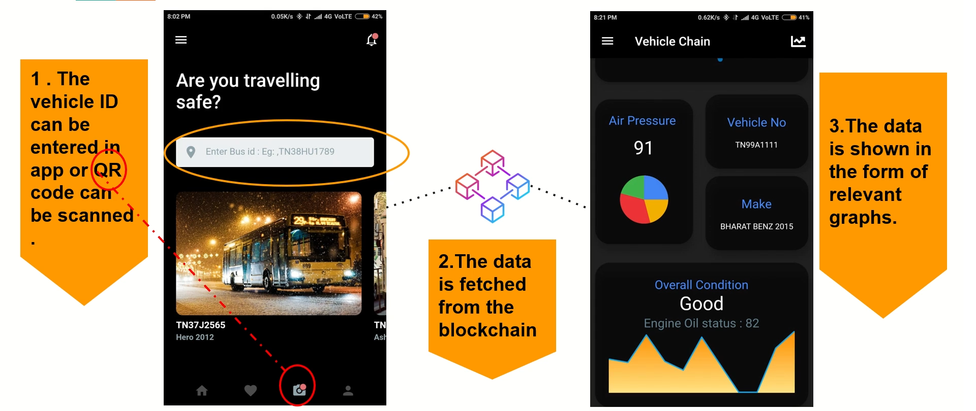
Wireframe

Slide 9
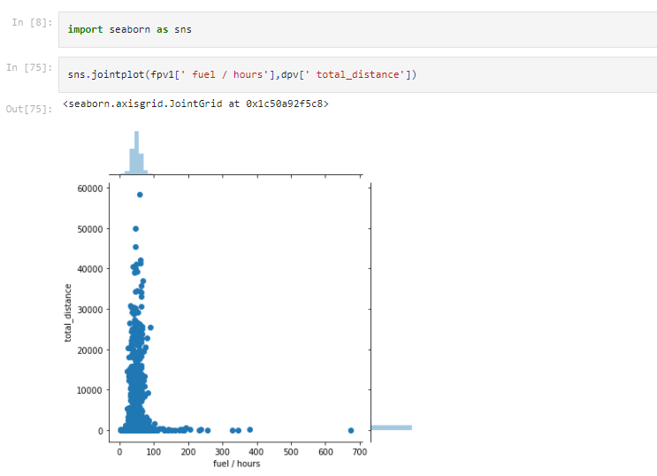
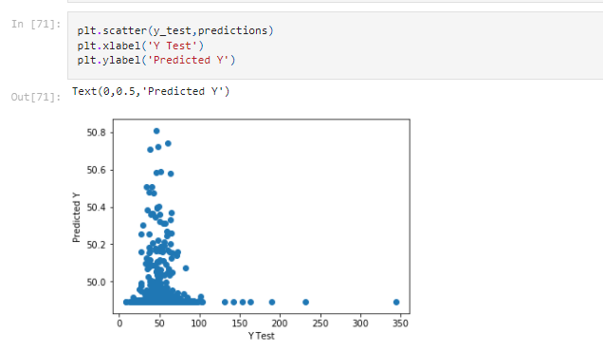
Graphical Representation

Slide 10
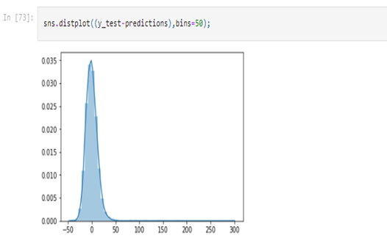
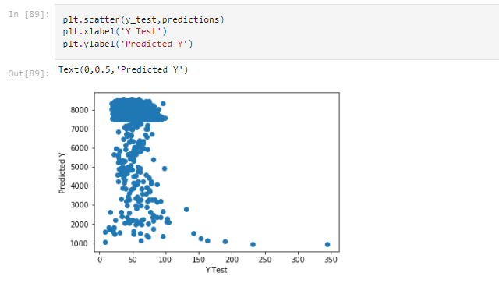
Analysis, Visualization

Slide 11
Working Prototype
Prototype link
https://drive.google.com/file/d/19UfD6ldaTKiieLJg78zIqTJGYqI83Xhh/view

Slide 12
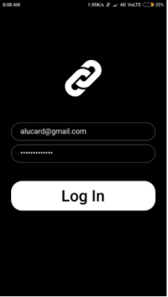
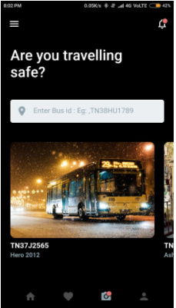
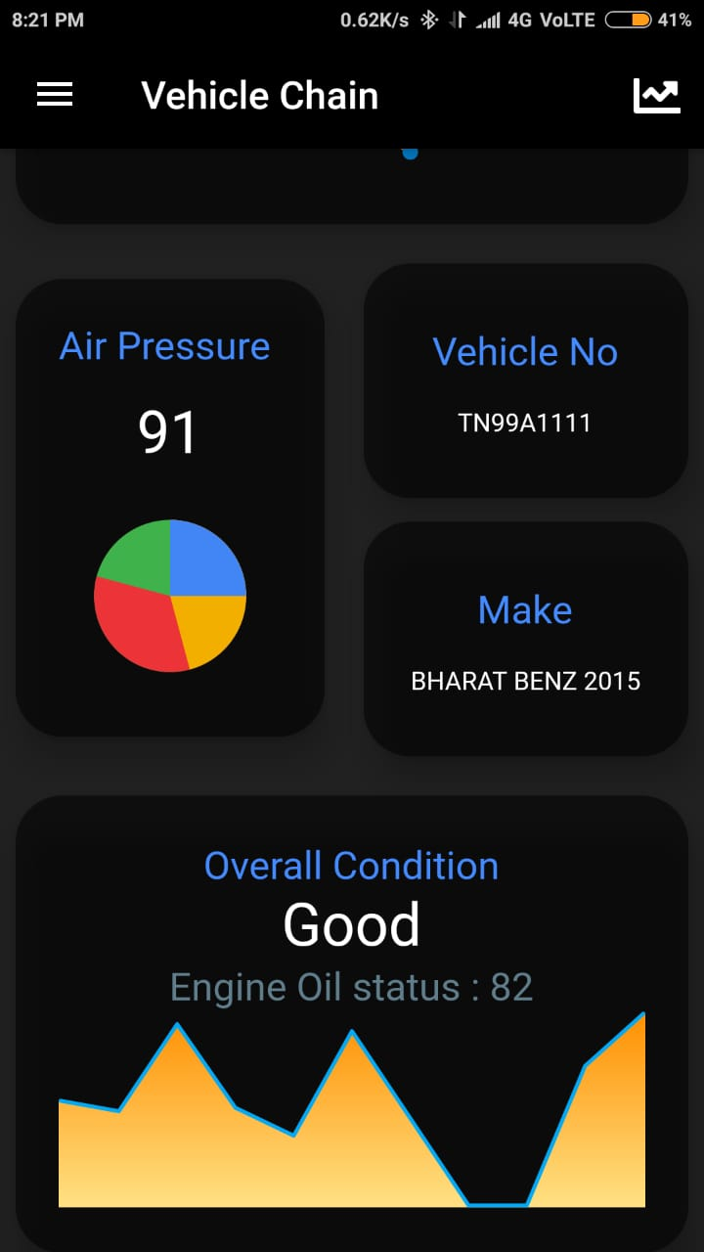
Attachments

Slide 13
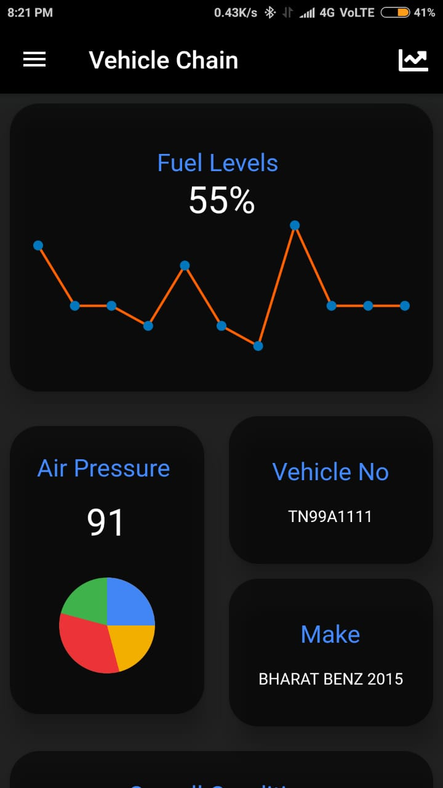
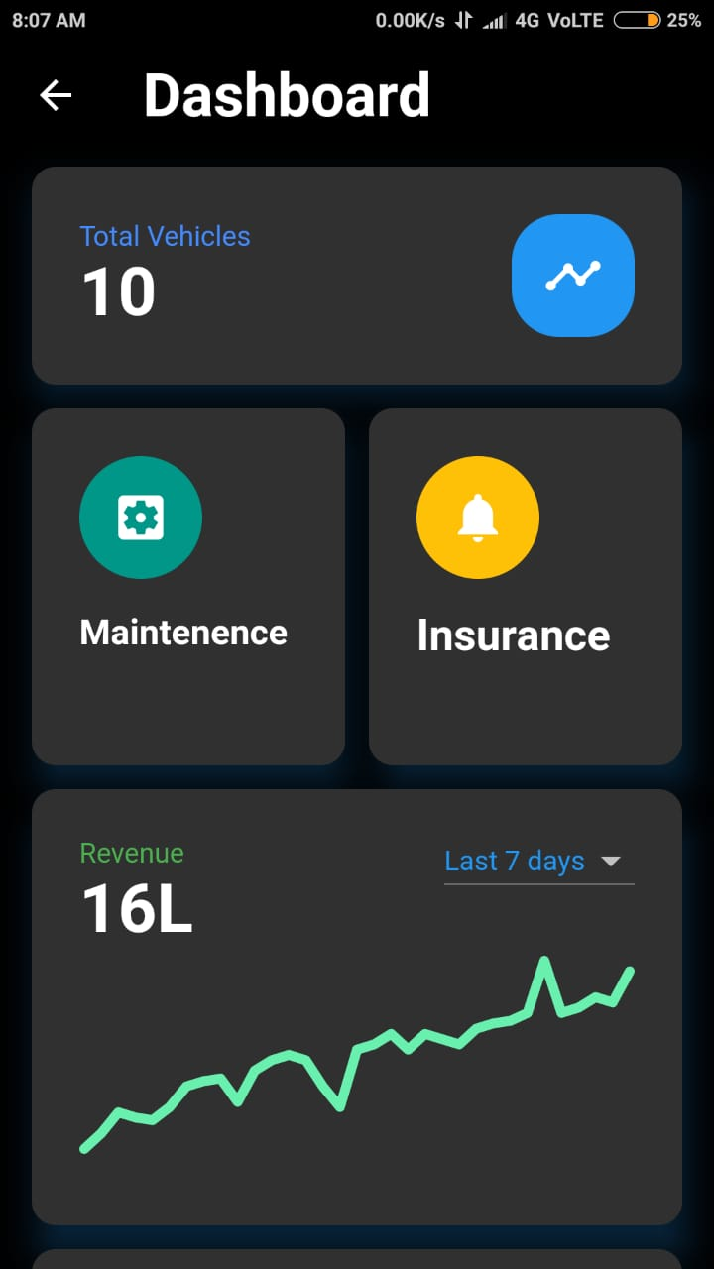

Slide 14


